Slide 1


Python Exercise
Basic data type

Slide 2
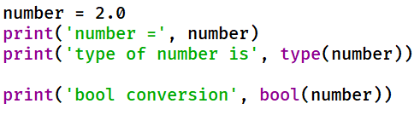
Question 1
What are the correct results of the following code after execution?
A. number = 2
B. number = 0
C. number = 2.0
D. type of number is <class ‘int’>
E. type of number is <class ‘float’>
F. type of number is <class ‘bool’>
G. type of number is <class ‘str’>
H. bool conversion True
I. bool conversion False

Slide 3
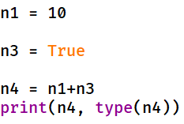
Question 2
What is the correct result of the following code after execution?
A. 10 <class ‘int’>
B. 11 <class ‘int’>
C. 14.0 <class ‘float’>
D. 11.0 <class ‘float’>

Slide 4
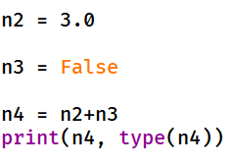
Question 3
What is the correct result of the following code after execution?
A. 3 <class ‘int’>
B. 3.0 <class ‘float’>
C. True <class ‘bool’>
D. 4.0 <class ‘float’>

Slide 5
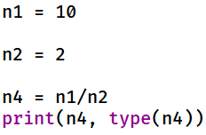
Question 4
What is the correct result of the following code after execution?
A. 10 <class ‘int’>
B. 5.0 <class ‘float’>
C. 5 <class ‘int’>
D. 10.0 <class ‘float’>

Slide 6
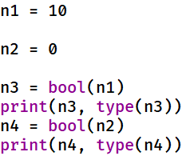
Question 5
What is the correct result of the following code after execution?
True <class ‘bool’>
False <class ‘bool’>
False <class ‘bool’>
True <class ‘bool’>
True <class ‘bool’>
True <class ‘bool’>
False <class ‘bool’>
False <class ‘bool’>
E. 10 <class ‘int’>
0 <class ‘int’>
F. 10.0 <class ‘float’>
0 <class ‘int’>
G. 10.0 <class ‘float’>
0.0 <class ‘float’>

Slide 7
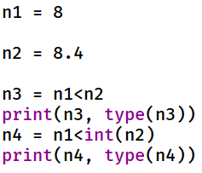
Question 6
What is the correct result of the following code after execution?
True <class ‘bool’>
False <class ‘bool’>
False <class ‘bool’>
True <class ‘bool’>
True <class ‘bool’>
True <class ‘bool’>
False <class ‘bool’>
False <class ‘bool’>
E. 8 <class ‘int’>
0 <class ‘int’>
F. 8.4 <class ‘float’>
8 <class ‘int’>
G. 8.4 <class ‘float’>
8.0 <class ‘float’>

Slide 8
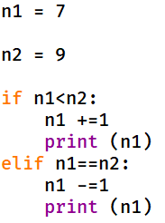
Question 7
What is the correct result of the following code after execution?
A. 8
8
7
B. 8.0
8.0
7.0
C. 7
7
6
D. 9
9
8

Slide 9

Question 8
What is the correct result of the following code after execution?
2
3
4
2
4
6
0
2
4
1
2
3
1
3
5
1
3
5
2
4
6
7
1
3
5
7

